Slide 1
ENVIRONMENTAL MONITORING
PHASE 3: Development part 1

Slide 2
AGENDA
INTORDUCTION
HARDWARE SETUP
IOT DEVICE CONFIGURATION
DATA COLLECTION SCRIPT DEVELOPMENT
REAL-TIME DATA UPDATES AND TESTING

Slide 3
INTRODUCTION
Environmental sensors are a series of sensors that monitor the environment and identify the quality of the environment. Environmental sensors include: soil sensors, temperature and humidity sensors, gas sensors, rainfall sensors, light sensors, wind speed and direction sensors, etc. Not only can environmental information be accurately measured, but the data can also be tested, recorded and stored

Slide 4
HARDWARE SETUP
Sensor data acquisition is done in layer 4. And layer 5 as ambient intelligence environment. The sensors can be operated by the microcontroller to retrieve the data from them and it processes the analysis with the sensor data and updates it to the Internet through Wi-Fi module connected to it. User can monitor the parameters on their smart phones as well as pc or laptop
The Arduino Uno is a microcontroller board based on the ATmega328. It has 14 digital input/output pins (of which 6 can be used as PWM outputs), 6 analog inputs, a 16 MHz ceramic resonator, a USB connection, a power jack, an ICSP header, and a reset button

Slide 5
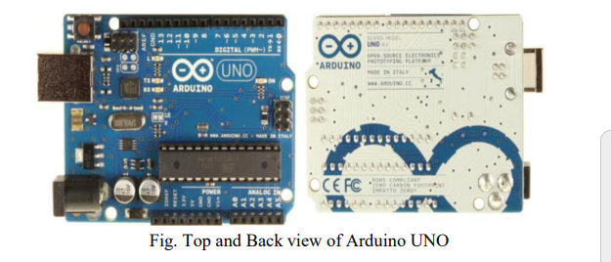

Slide 6
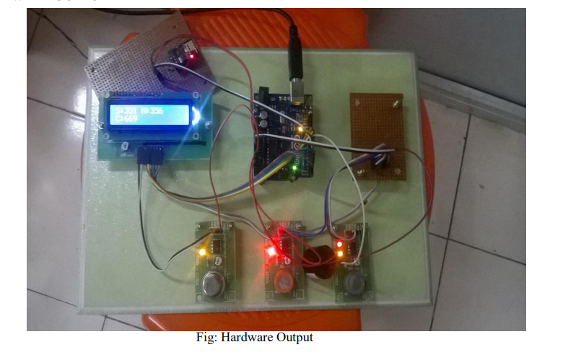
HARDWARE OUTPUT

Slide 7
Fig. represents the output we have obtained so far. The Hardware components used here includes Arduino microcontroller, ESP 8266 Wi-Fi module, LCD, Buzzer, CO sensor, SnO2 sensor and LPG sensor. LCD display indicates density of gases in the air. The Buzzer gave alarm when the gas level exceed the threshold value. ESP 8266 Wi-Fi module transmitted the data to the web server.

Slide 8
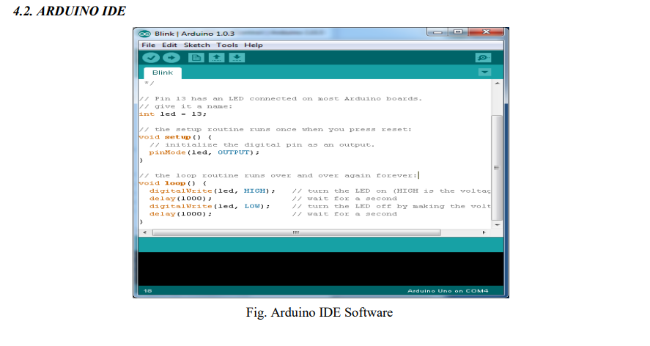

Slide 9
THINGSPEAK Thing Speak is the cloud based web server for IOT Applications. It is an open source. In which we created our own channel for IOT based Environmental monitoring by providing username and password. The output is obtained by setting the number of field we required for monitoring the Environment parameters. Then the sensors values are updated to the server using ESP 8266.It provided the graph to show the density of gases in the air.

Slide 10
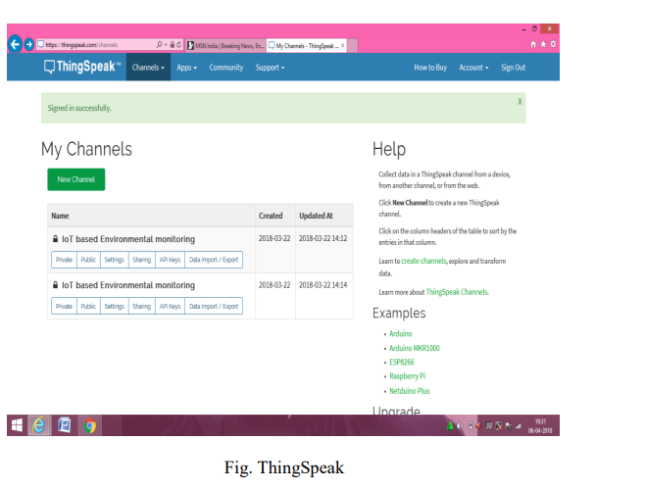

Slide 11
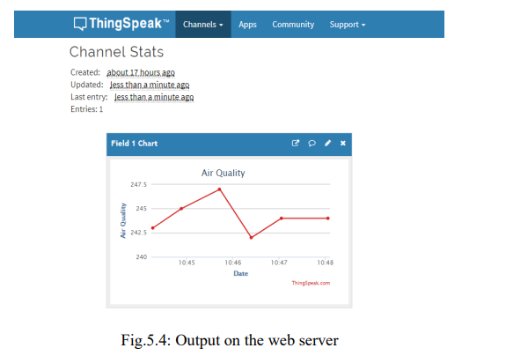
OUTPUT ON THE WEBSERVER

Slide 12
CONCLUSION
Thus the IOT based Environmental Monitoring System has been designed and implemented. The Environmental parameters successfully transmitted via ESP 8266 Wi-Fi module. The density of the gases in the remote located area viewed through the ThingSpeak web server. This project will protect the people from the pollutant gases. It is more useful for the Industries to control the air pollution in the surrounding area and for the workers safety. In future we can implement this project with ESP 8266-12E Wi-Fi module and with the sensors which can sense the gas density in high level. ESP 8266-12E module has inbuilt Arduino microcontroller. It reduces the overall size of the device and simplifies the working mechanism.

